Slide 1


NLP of Customer Reviews : Women’s Clothing Brand
ITC6010A1
Natural Language Processing
Instructor:
Lazaros Polymenakos
Alkiviadis Kariotis
Celsa Almeida
Georgios Aliferis
Konstantinos Margaritis

Slide 2
Presentation Overview
1.EDA
2.Sentiment Analysis
3.Topic Extraction
4.Text Summarization
5.LLM & DataFrame chatbot
6.Future Improvements

Slide 3

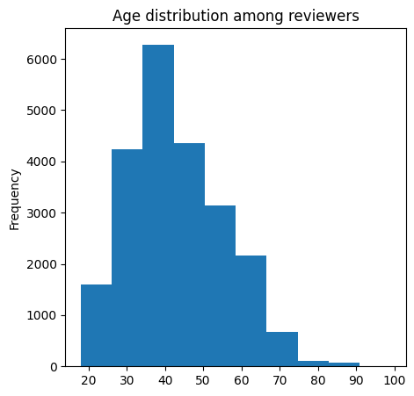
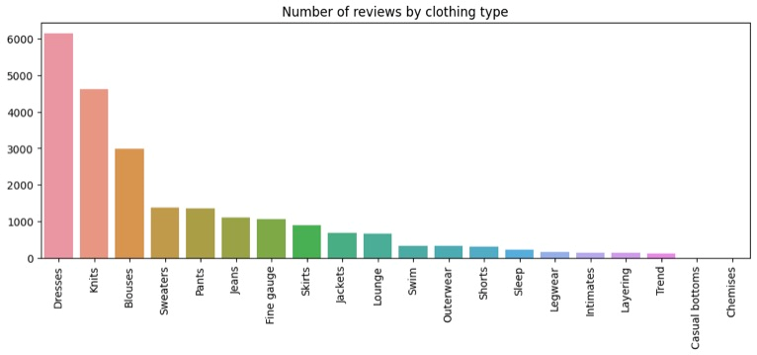
Dataset, Processing, Tokenization
Dataset Overview
Clothing ID | Age (Customer) | Title | Review Text | Rating | Recommended IND | Positive Feedback Count | Division Name | Department | Class Name
We prep the data by first checking and removing entries with missing values and then start preliminary examination as below

Slide 4
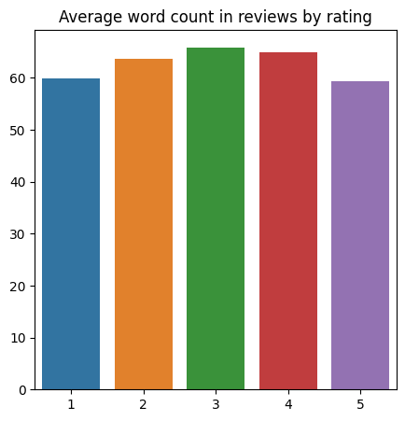
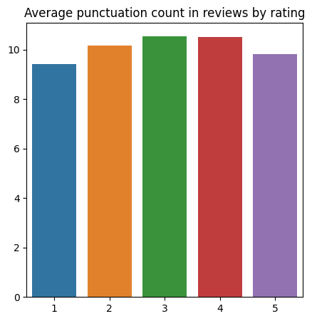
Dataset, Processing, Tokenization
This analysis gives an understanding of whether reviewers leaving high or low ratings tend to write longer or more complex reviews. In our case this does not happen.
Next, we change all text to lowercase,
removing punctuation and stopwords, lemmatize the text and Tokenize with NLTK's RegexpTokenizer

Slide 5
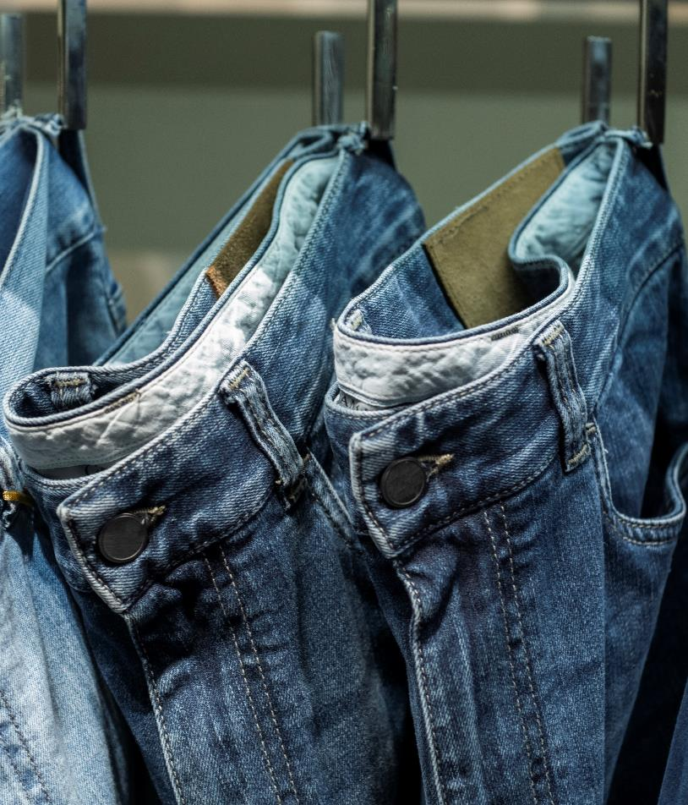
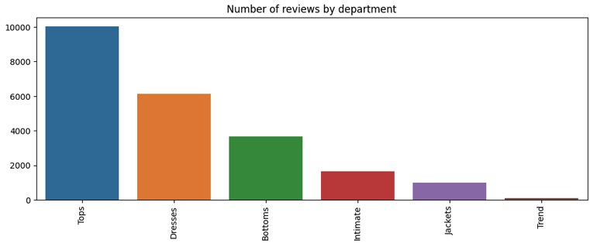
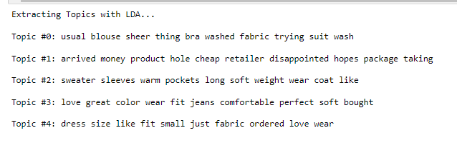
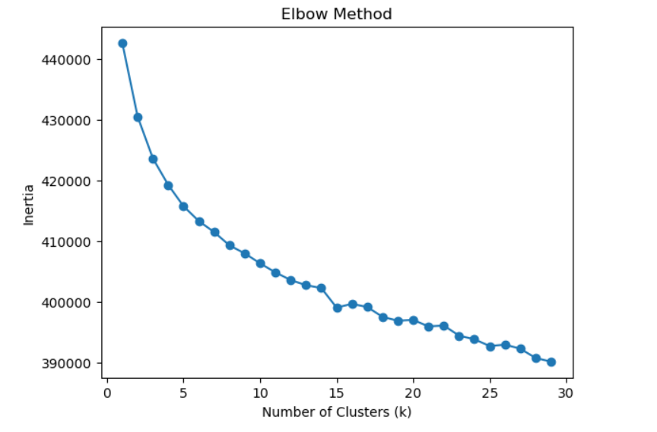
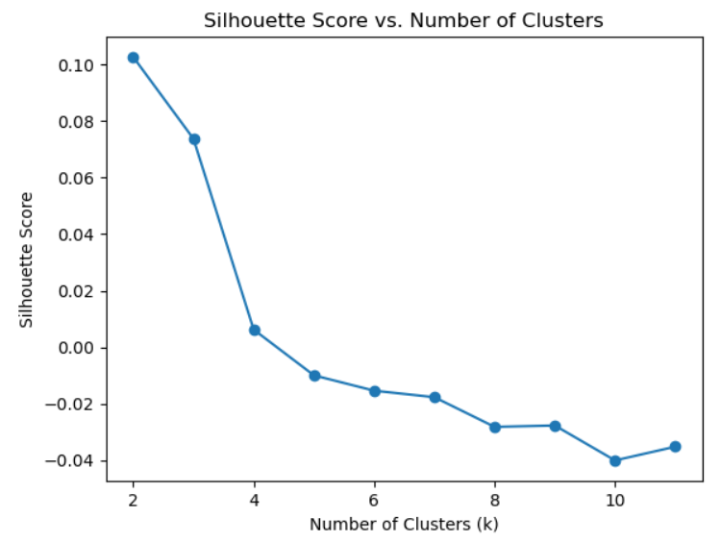
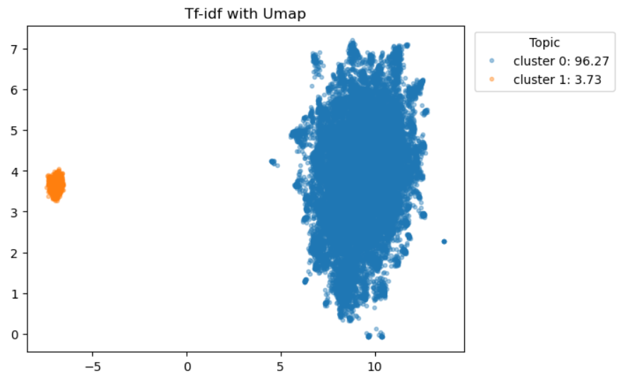
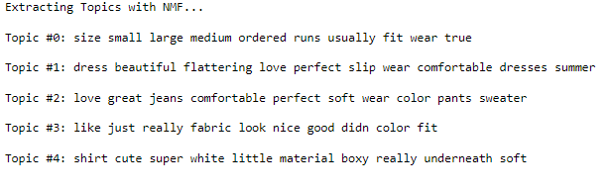
Exploring the Dataset Structure & Topic Modelling/Extraction
However, even though the clustering does not have clear/obvious significance, we know there are only 5 departments . The 'Trend' category consists of reviews of items from other departments and may be set aside. So , Likelihood of 5 matching topics.
In both extraction techniques, the top-10 most frequent words are determined for each topic in order of decreasing importance
Exploring Clusters
Extracting Topics with LDA
Tops
Intimates (possibly)
Jackets
Bottoms
Dress
Data Clusters
CountVectorizer +
Latent Dirichlet Allocation
Extracting Topics with NMF
Jackets/
Intimates
Dress
Bottoms
Jackets/
Intimates
Tops
TextTfidfVectorizer +
NMF (Non-Negative Matrix Factorization)
Term Freq-
Inverse Doc Freq
+
Uniform Manifold Approx. & Projection

Slide 6
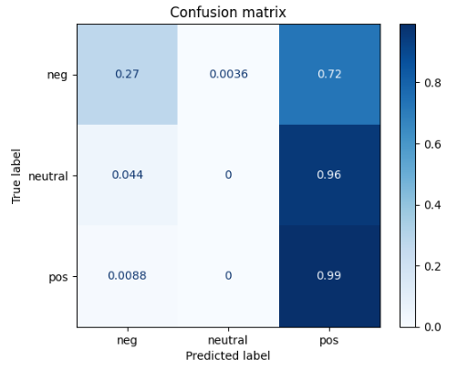
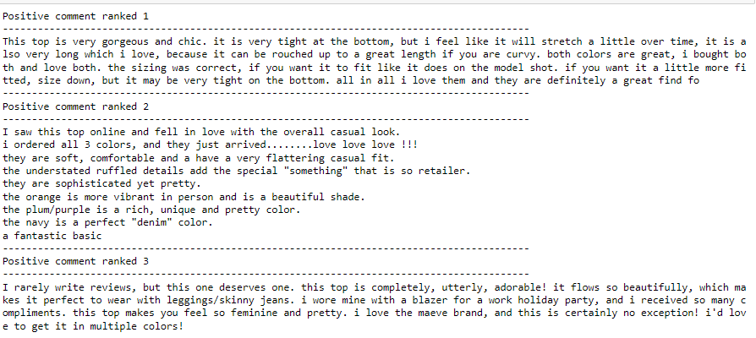
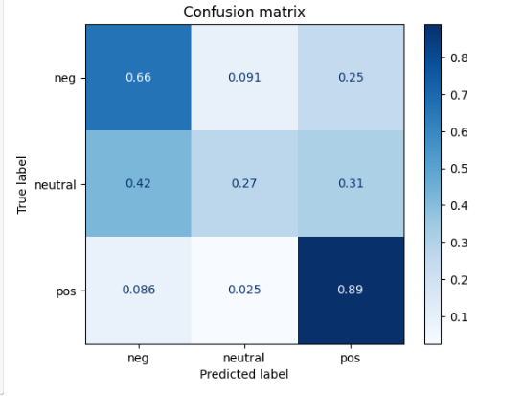
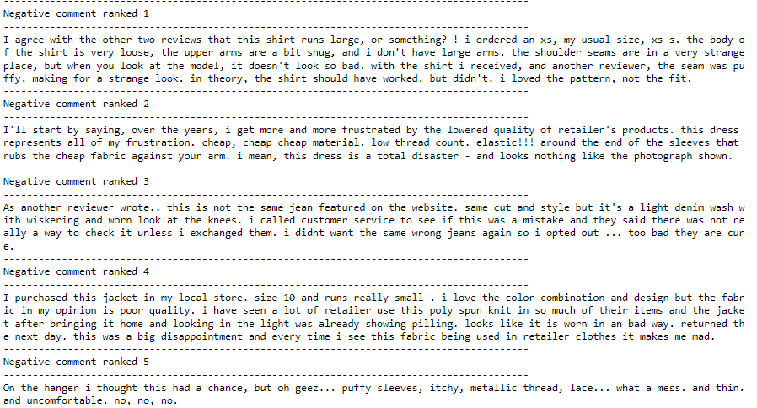
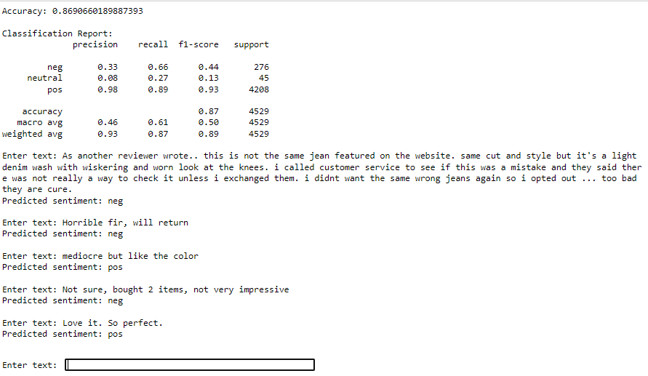
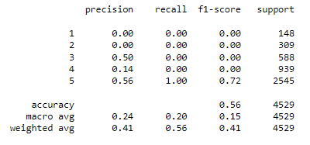
Sentiment Analysis
Sentiment Intensity Analyzer (NLTK)
Logistic Regression
From analyzer: compound'> 0.05 'pos'. 'compound'< -0.05, it is assigned as 'neg'. Otherwise 'neutral'.
Quantifies sentiment through lexicon-based scoring algorithm: Compound score of overall sentiment polarity, ranges from -1 (most negative) to 1 (most positive)
Pipeline combining text feature extractor using TF-IDF vectorization and logistic regression classifier:
Grid Search for best hyperparameters, cross-validation and evaluating accuracy.
Training and Metrics
Up-sampling Minority Class
RandomOverSampler used to address dataset bias to 5-star reviews.
Logistic regression model fitted on the up-sampled data
Considering we have 5 labels of sentiment in our dataset, we initially try to map the compound score to these labels or levels: 'compound' <-0.56586 :1, -0.56586 <compound<-0.17552: 2, -0.17552 <compound<0.21482: 3 0.21482 <'compound<0.60516 :4 , and 5 otherwise. An initial exploratory Multinomial Naive Bayes classifier showed poor metrics for low ratings .

Slide 7
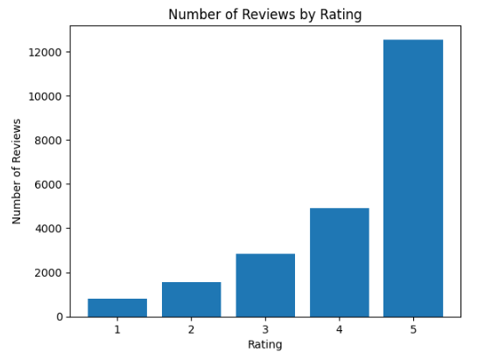
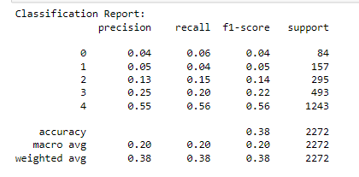
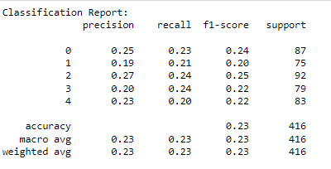
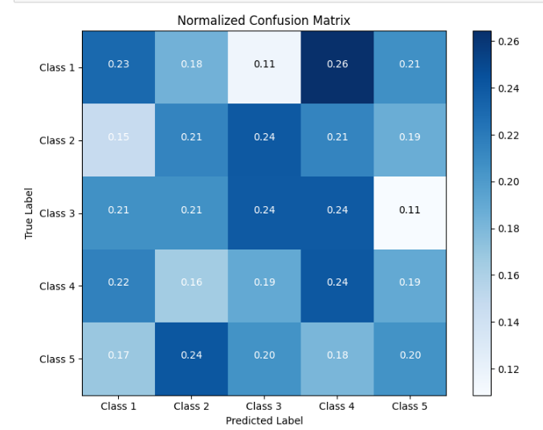
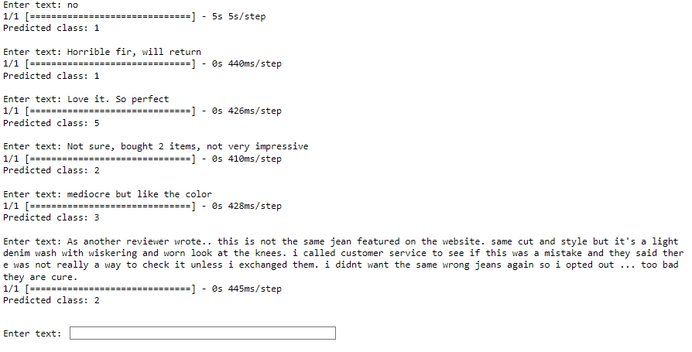
Sentiment Analysis
Bert-base model+Neural Network Layers
(Tensorflow)
BERT base model with layers trained to 90.2 %. Model evaluated . Text classified with rating
Undersampling for equal no. of samples for each rating jeopardizes prediction of 5 rating. Possible overfitting.
Solution: To Use pretrained sentiment model to fine-tune on our dataset: Pytorch+NLPtown (nlptown/bert-base-multilingual-uncased-sentiment )- need for discrete GPU

Slide 8

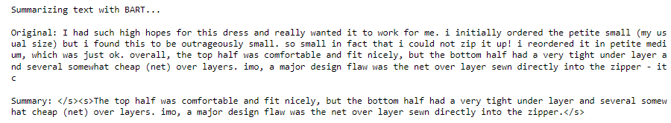
Text Summarization (with BART)
Why BART?
Autoencoder --> NN for unsupervised learning
Autoregressive --> Sequential data predictions on the previously generated outputs
Reducing lengthy reviews to be more cost and time efficient
Text encoded with BART tokenizer. Generate method of the BART model uses encoded to summarize
Denoising encoder --> reconstruct original text after "noise" integration.

Slide 9


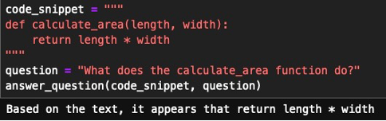
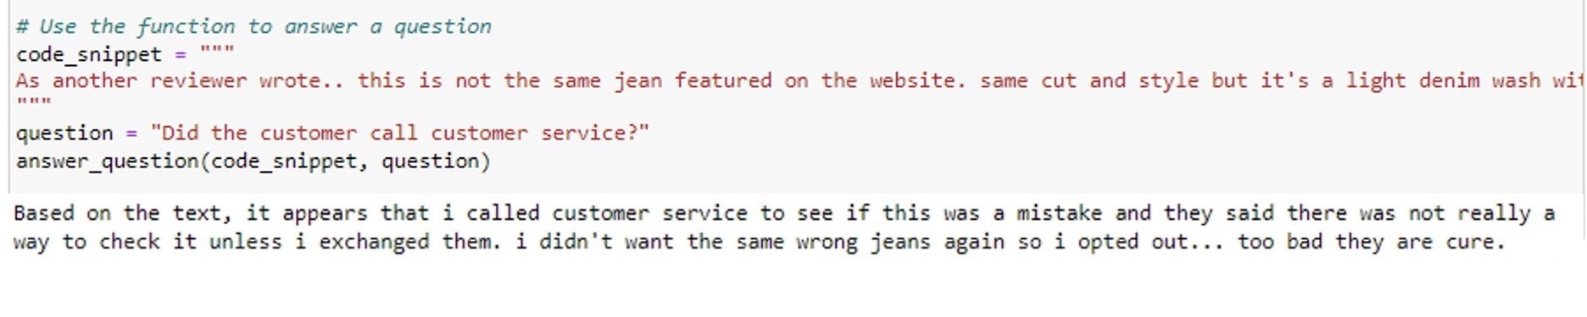
‘Conversing’ with the Data
FLAN-T5-base model
First Approach
Input : code snippet and a question
Generates: Tokenizes combo of code snippet and question and models the answer

Slide 10
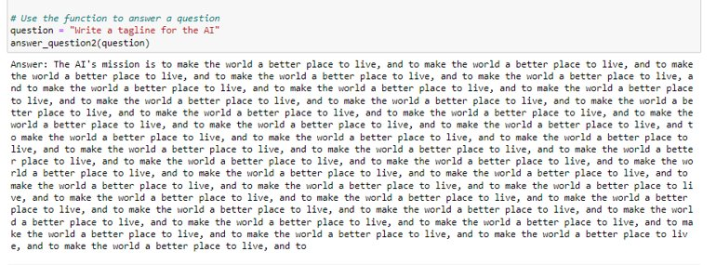
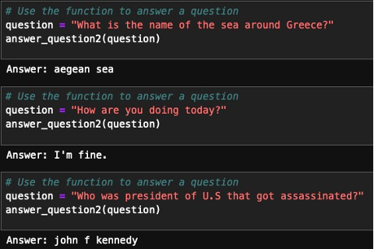
‘Conversing’ with the Data
FLAN-T5-base model
Second Approach
Only takes a question as input and directly tokenizes the question and generates the output answer using the model.

Slide 11
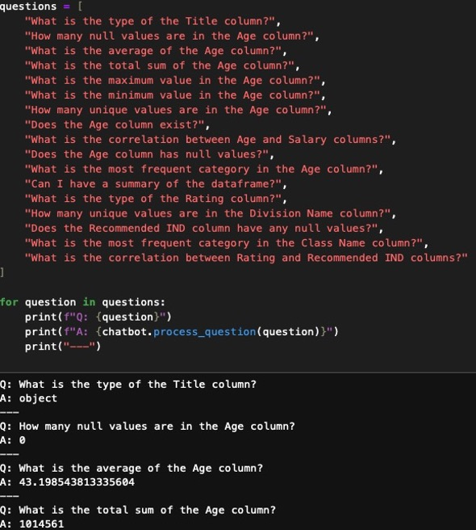
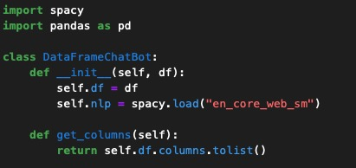
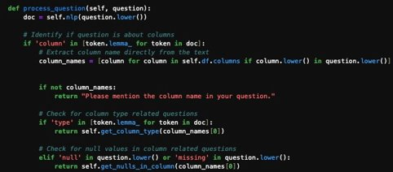
‘Conversing’ with the Data
DataFrameChatBot
How we approached it?
We used spacy to load their nlp model.
We created a function that would search for the answer for the premade question.
We created another function that will structure the answer for the premade question.

Slide 12

Summary & Future Improvements
Create a full data pipeline through connecting the results of the methods.
Take the answers from the LLM model and categorize them, so reviews can automatically assigned. Categorize fresh reviews w.r.t. topics/departments and update dataset/DB.
Predict behaviour of neutral reviewers (subset of reviews + recommend/not recommend sentiment binary classification)
Limitations of Dataset: Unusually strong bias to 5 star ratings

Slide 13

Thank you

